Slide 1
Doctors of Data
Missing People Challenge
Jeff D, Jaime J, Ashish N

Slide 2

The Missing People Challenge
What and how much do we know about the missing people ?
Are the disappearances truly random? or is there a correlation with geo/demo?

Slide 3
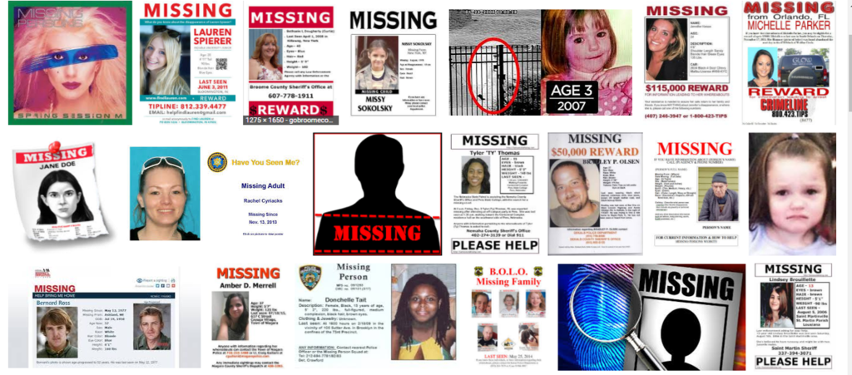
Some quick findings from NCIS data
647,435 new missing cases added in 2016 a 2% increase compared to cases added in 2015 (634,908)
Out of which 644,294 cases were purged for reasons including subject located/returned home etc
88,000+ open cases at end of 2016
Missing juveniles account for 38.3% or 48.6%, depending on state definitions

Slide 4




Investigative Journey
Identify Data Sources
Organize Data
Exploratory Data Analysis
Test Hypothesis
Completeness
Relevance (how recent)
Outliers
Manually fill in missing information
Normalized data set
Matching data sets to Census
Missing Children’s data since 1938 through 2017
Total Missing Children’s cases open 3,863
Additionally about 100+ were John Doe/ Jane Doe without any other information
Missing US cases only
Higher the state population, more missing children cases
Most juvenile disappearances are due to abductions
Children go missing from poor neighborhoods

Slide 5
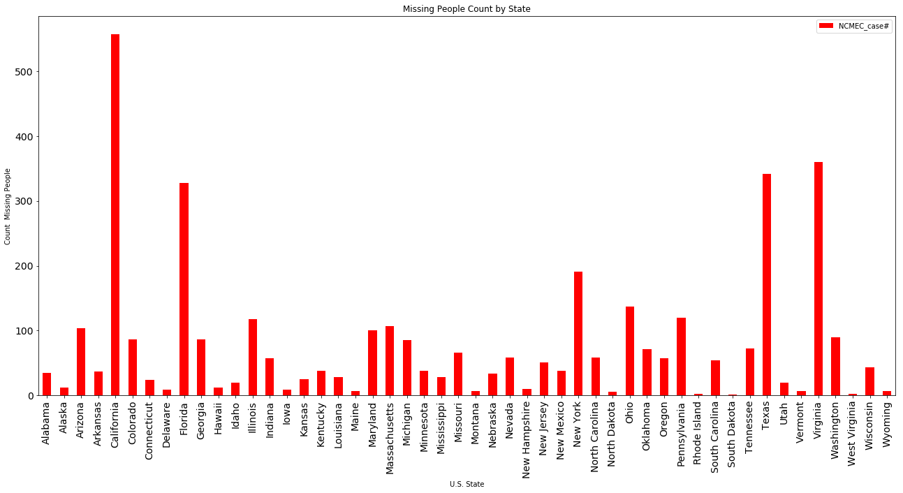
Facts – based on NCMEC dataset
Total missing cases currently open are 3,818
CA, FL, VA, TX, NY floating to the top
SD, WV, RI, ND, WY floating to the top

Slide 6
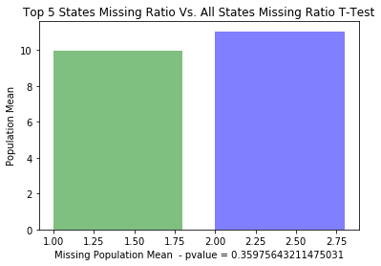
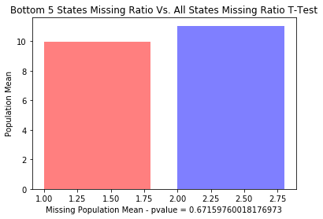
Disappearances & population
CA, TX, FL, NY, IL
WY, VA, AL, ND, SD
Looking at the Top 5 States and Bottom 5 States there does not seem to be a correlation between overall population and disappearances

Slide 7
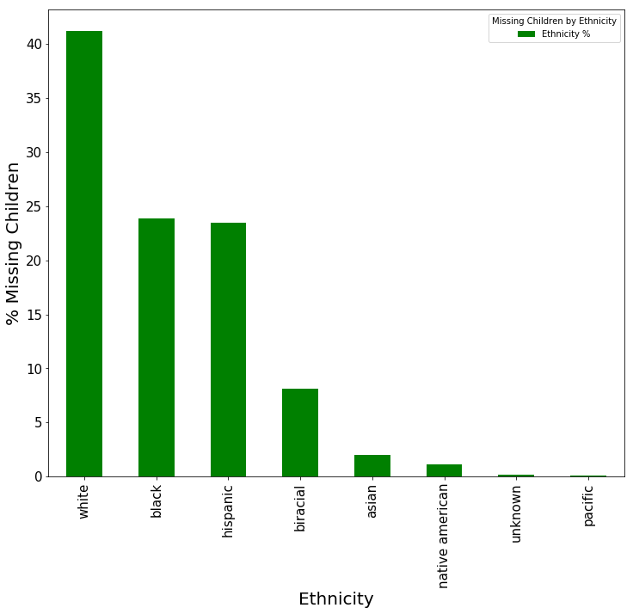
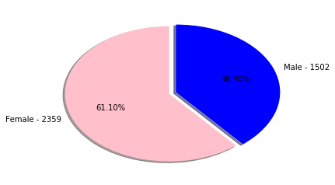
Disappearances by Gender/Ethnicity

Slide 8
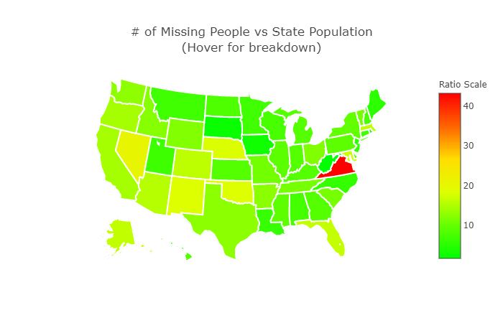
VA

Slide 9
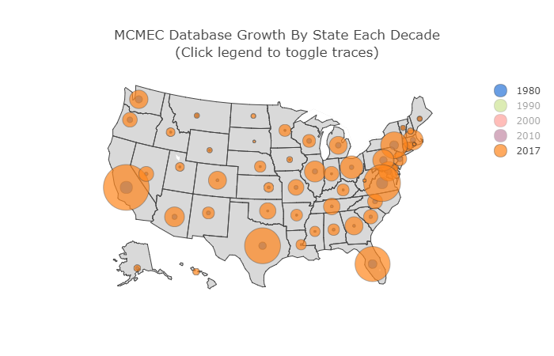

Slide 10
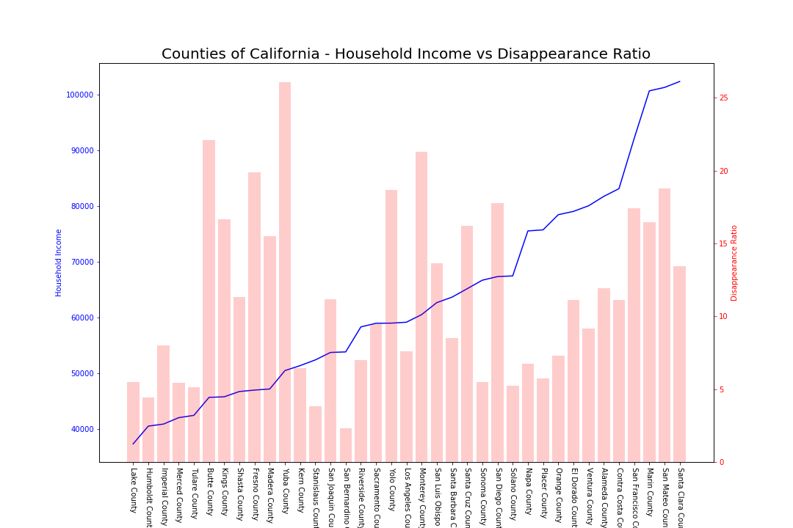

Slide 11
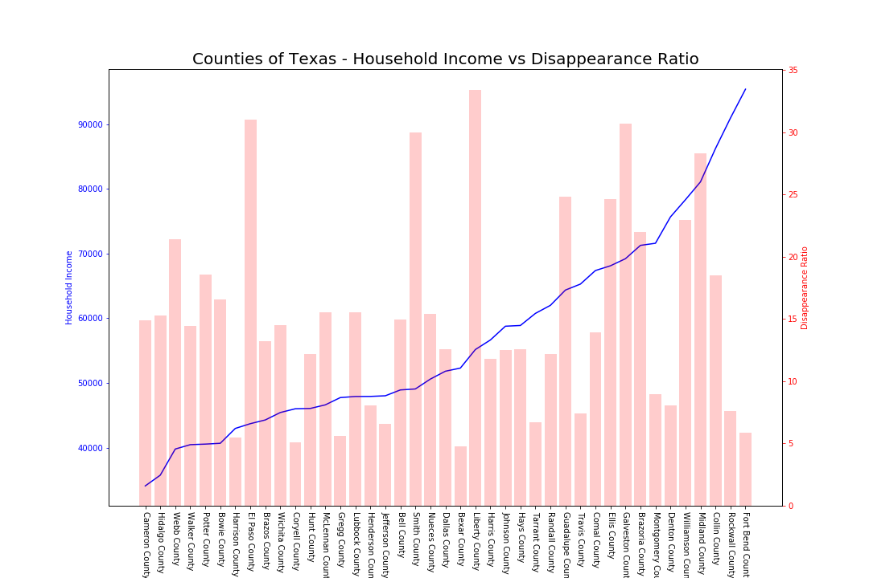

Slide 12
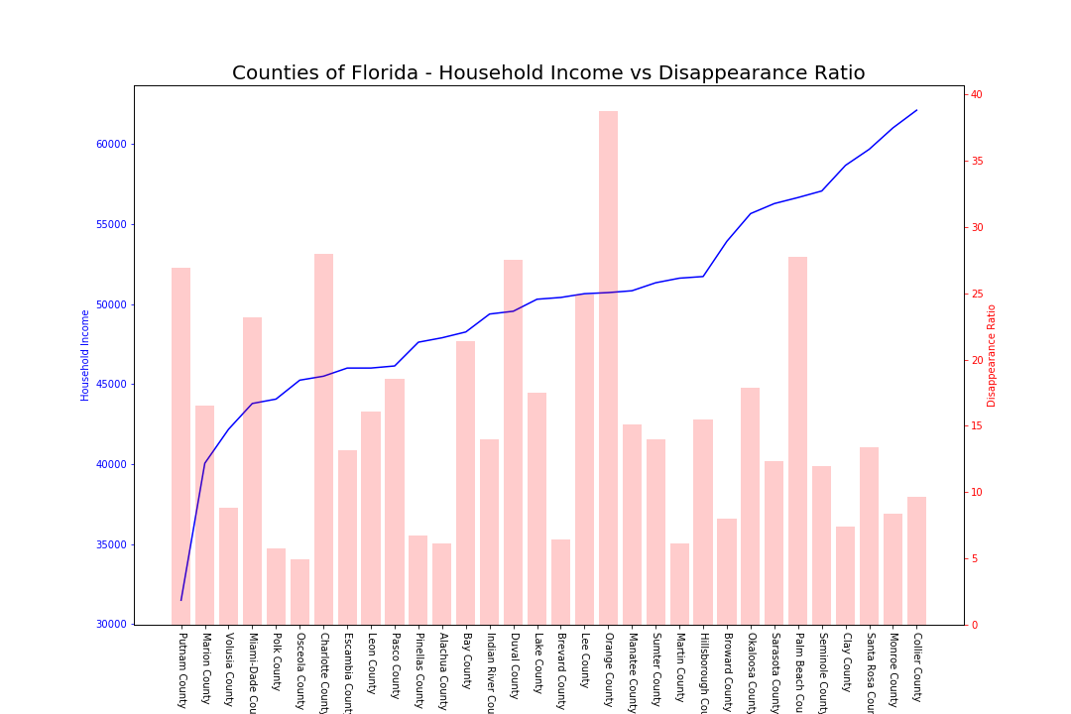

Slide 13
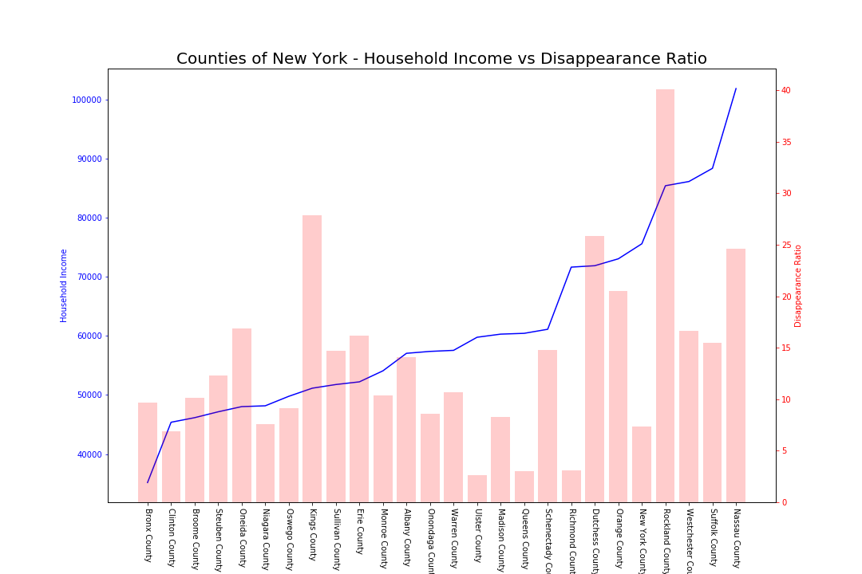

Slide 14
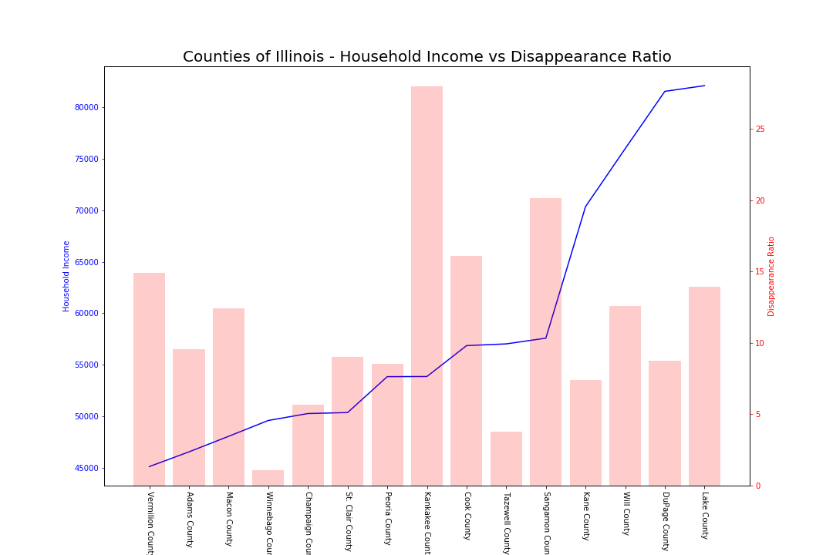

Slide 15
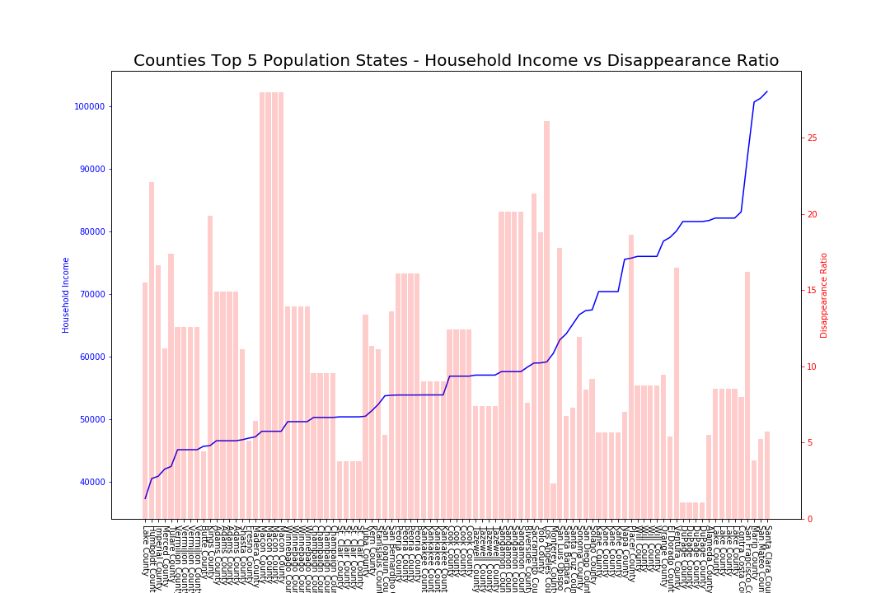

Slide 16
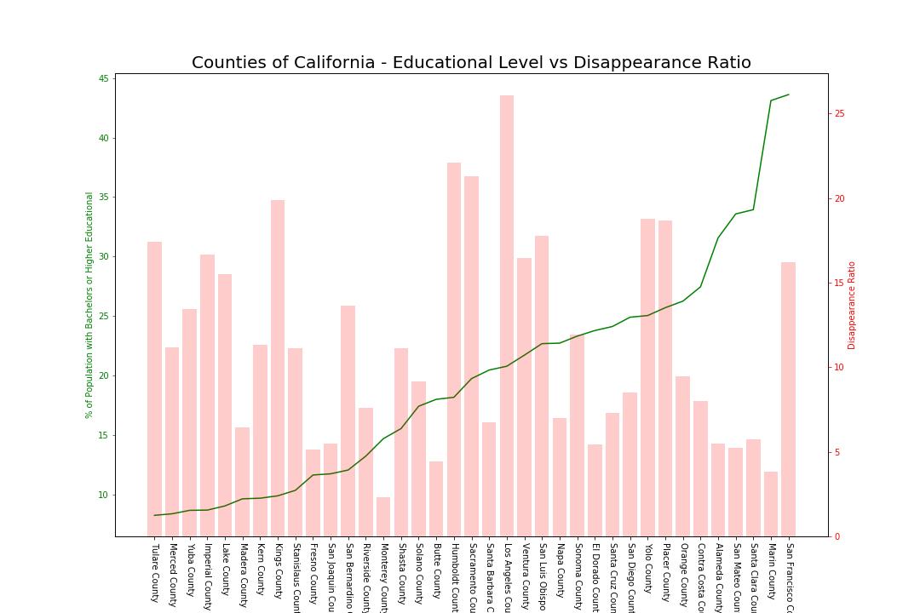

Slide 17
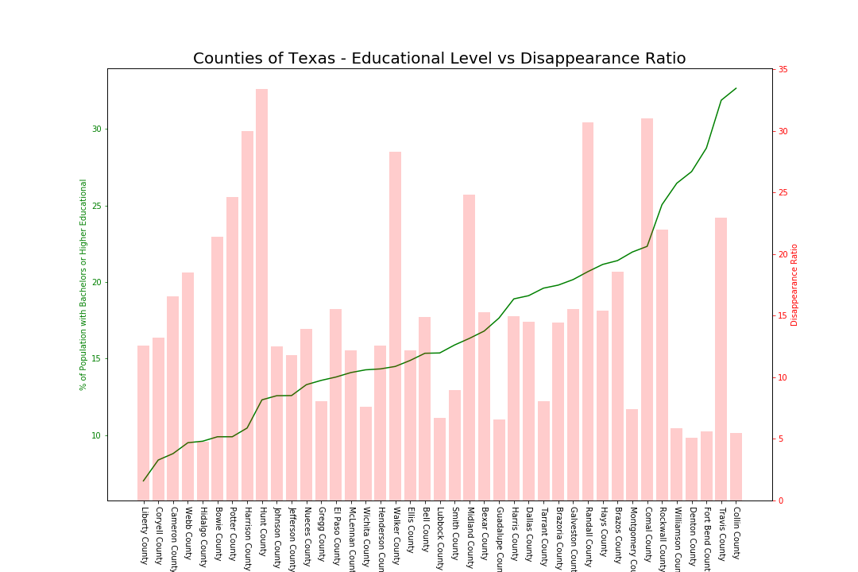

Slide 18
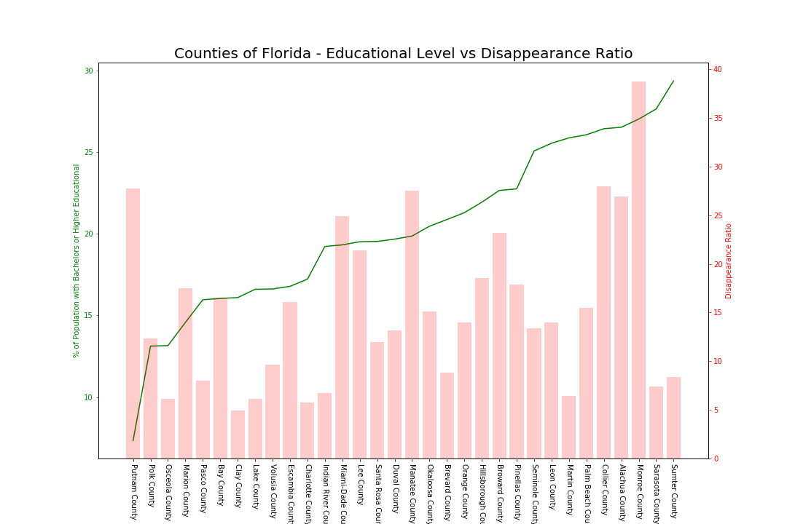

Slide 19
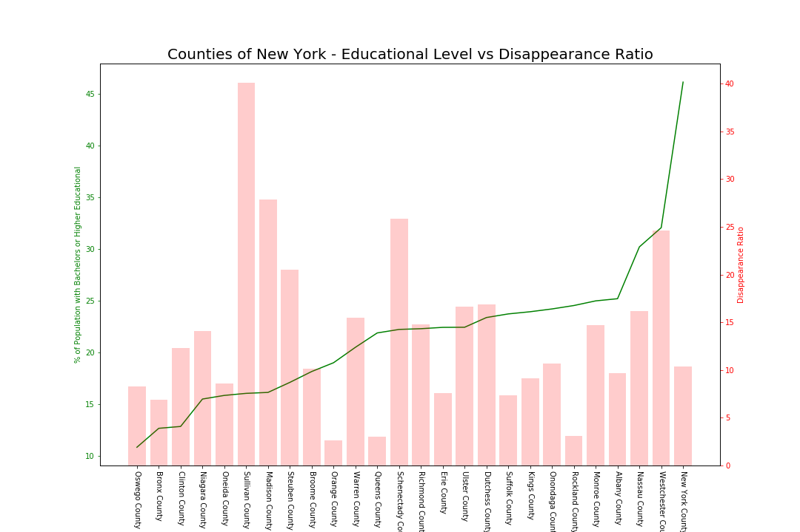

Slide 20
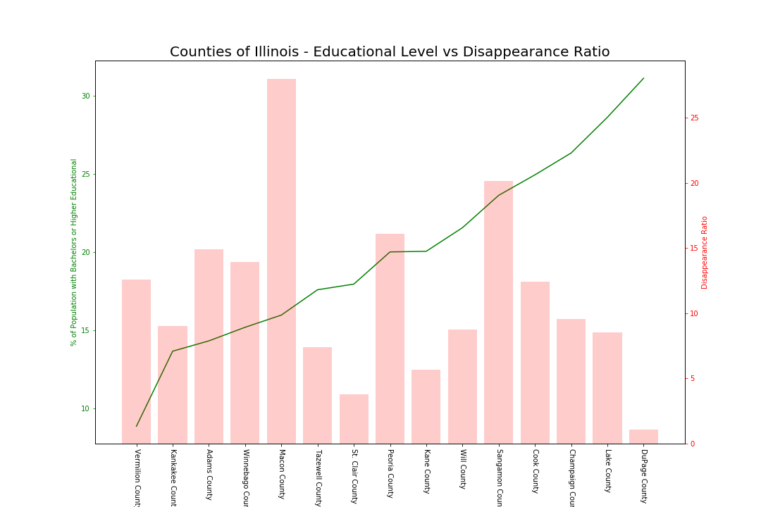

Slide 21
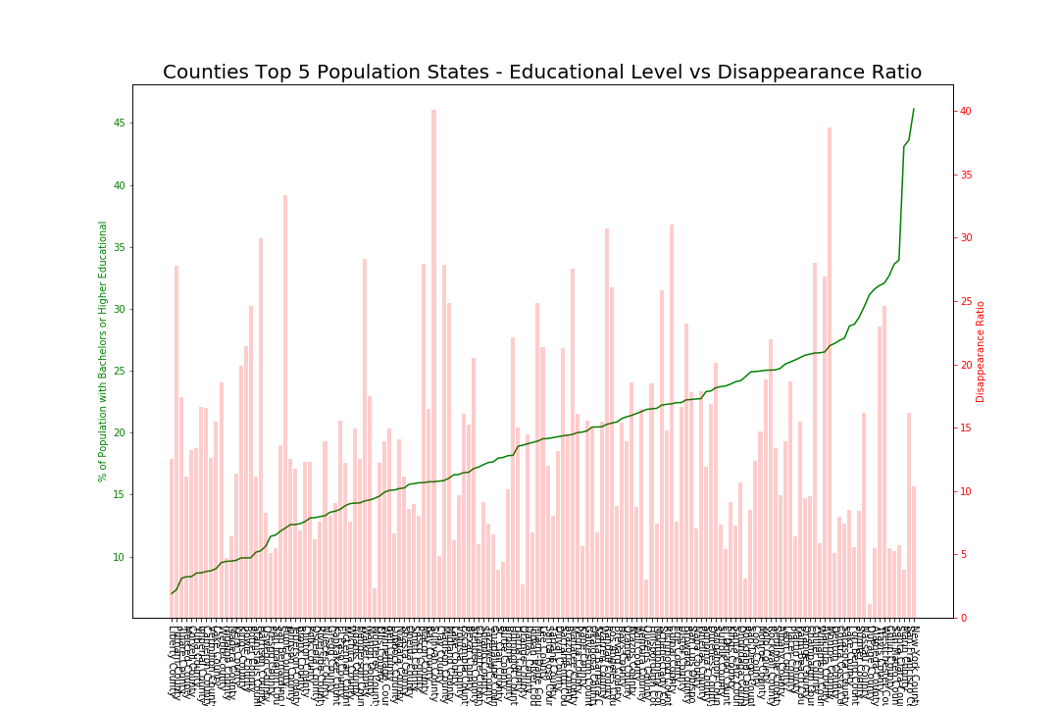

Slide 23
To be continued….
Certain Ethnic groups have missing children problem ?
Focus on Virginia – an Outlier?
What is the correlation between missing children and
education level
Occupation
Borders ?

